Slide 2
Unit
10
ENERGY SOURCES
LESSON 4: COMMUNICATION
Unit
HOBBIES

Slide 3
OBJECTIVES
By the end of the lesson, students will be able to:
Ask for explanations
Talk about how well your partner saves energy.

Slide 4
LESSON 4: COMMUNICATION
WARM-UP
Game: BRAINSTORMING
Everyday English
Task 1: Listen and read the conversation. Pay attention to the highlighted questions.
Task 2: Work in pairs. Make similar conversations to ask for explanations.
Saving energy
Task 3: Work in pairs. Ask your partner the following questions and tick his or her answers in the boxes.
Task 4: Work in groups. Speech: how well your partner saves energy
EVERYDAY ENGLISH
SAVING ENERGY
PRODUCTION
Task 5: Answer the questions in 3 on your own. Speech: how well you save energy
CONSOLIDATION
Wrap-up
Home work

Slide 5
LESSON 2: A CLOSER LOOK 1
WARM-UP
Game: Brainstorming
Aims of the stage:
To lead in the lesson

Slide 6
WARM-UP
TYPES OF ENERGY

Slide 7
LESSON 4: COMMUNICATION
WARM-UP
Game: BRAINSTORMING
Everyday English
Task 1: Listen and read the conversation. Pay attention to the highlighted questions.
Task 2: Work in pairs. Make similar conversations to ask for explanations.
Saving energy
Task 3: Work in pairs. Ask your partner the following questions and tick his or her answers in the boxes.
Task 4: Work in groups. Speech: how well your partner saves energy
EVERYDAY ENGLISH
SAVING ENERGY

Slide 8
PRACTICE
1
Everyday English
Aims of the stage:
To let students know the structure to ask and answer for explanation.

Slide 9
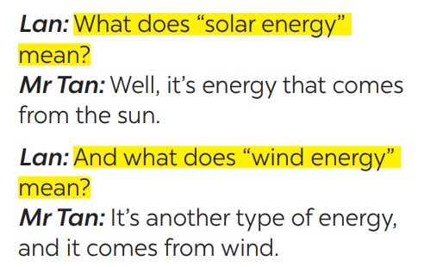
PRESENTATION
1
Listen and read the conversation. Pay attention to the highlighted questions.
Which tense do we use to ask and answer?
Which question word and verb do we use?

Slide 10
PRESENTATION
STRUCTURES
WHAT +DOES + S + MEAN…?
S + MEANS …
Which question word and verb do we use?
Which question word and verb do we use?

Slide 11
PRACTICE
1
Everyday English
Aims of the stage:
To help students practise on how to ask and answer for explanations.

Slide 12
PRACTICE
2
Work in pairs. Make similar conversations to ask for explanations.
What does hydro energy mean?
It’s energy that comes from the sun. What does nuclear energy mean?
It’s energy that comes from the nuclear power.

Slide 13
LESSON 4: COMMUNICATION
WARM-UP
Game: BRAINSTORMING
Everyday English
Task 1: Listen and read the conversation. Pay attention to the highlighted questions.
Task 2: Work in pairs. Make similar conversations to ask for explanations.
Saving energy
Task 3: Work in pairs. Ask your partner the following questions and tick his or her answers in the boxes.
Task 4: Work in groups. Speech: how well your partner saves energy
EVERYDAY ENGLISH
SAVING ENERGY

Slide 14
PRACTICE
SAVING ENERGY
Aims of the stage:
To provide students with more awareness of ways to save energy and help them practice the skill of speaking.

Slide 15
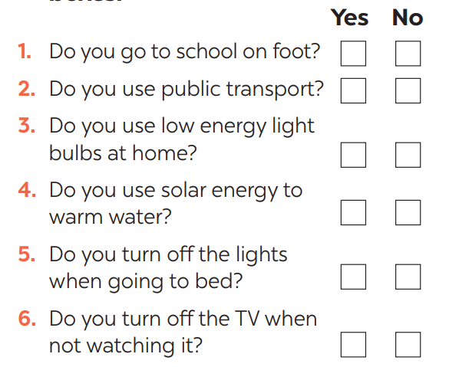
PRACTICE
3
Work in pairs. Ask your partner the following questions and tick his or her answers in the boxes.

Slide 16
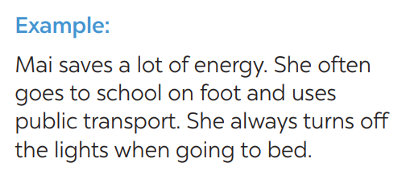
PRACTICE
4
Work in groups. Speech: how well your partner saves energy.

Slide 17
LESSON 4: COMMUNICATION
WARM-UP
Game: BRAINSTORMING
Everyday English
Task 1: Listen and read the conversation. Pay attention to the highlighted questions.
Task 2: Work in pairs. Make similar conversations to ask for explanations.
Saving energy
Task 3: Work in pairs. Ask your partner the following questions and tick his or her answers in the boxes.
Task 4: Work in groups. Speech: how well your partner saves energy
EVERYDAY ENGLISH
SAVING ENERGY
PRODUCTION
Task 5: Answer the questions in 3 on your own. Speech: how well you save energy

Slide 18
PRODUCTION
Aims of the stage:
To help students practicing speaking about saving energy

Slide 19
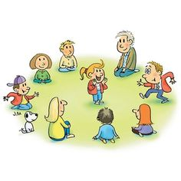
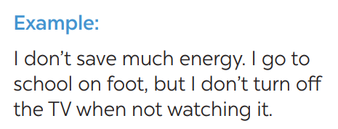
PRODUCTION
5
Answer the questions in 3 on your own. Speech: how well you save energy

Slide 20
LESSON 4: COMMUNICATION
WARM-UP
Game: BRAINSTORMING
Everyday English
Task 1: Listen and read the conversation. Pay attention to the highlighted questions.
Task 2: Work in pairs. Make similar conversations to ask for explanations.
Saving energy
Task 3: Work in pairs. Ask your partner the following questions and tick his or her answers in the boxes.
Task 4: Work in groups. Speech: how well your partner saves energy
EVERYDAY ENGLISH
SAVING ENERGY
PRODUCTION
Task 5: Answer the questions in 3 on your own. Speech: how well you save energy
CONSOLIDATION
Wrap-up
Home work

Slide 21
CONSOLIDATION
1
WRAP-UP
In this lesson, we have learn to:
Ask for explanations
Talk about saving energy

Slide 22
CONSOLIDATION
2
HOMEWORK
Do exercises in the workbook.

